Slide 1



Tech 204
Final Project
James Durst
04/25/2025

Slide 2


Introduction
Inventory of Parts and Software
Precision of the Ultrasonic Sensor
Gravitational Acceleration of a Free-Falling Object
Conservation of Energy of a Free-Falling Object
Relationship between Linear and Rotational Motion
Observing the Hall Effect

Slide 3

Inventory of Parts and Software

Slide 4

Ultrasonic Sensor HC-SR04
Describe the working principles of ultrasonic sensors in detail.
  Answer: An ultrasonic sensor is an instrument that measures the distance to an object using ultrasonic sound waves. It uses a transducer to send and receive ultrasonic pulses that relay back information about an object’s vicinity. The high-frequency sound waves reflect across boundaries to produce echo patterns. The sound wave is at a frequency above the range of human hearing. The transducer of the sensor acts as a microphone to receive and send the ultrasonic sound. The sensor determines the distance to a target by measuring time lapses between the sending and receiving of the ultrasonic pulse.

Slide 5

Rotary Encoder KY-040
Describe the working principles of rotary encoders in detail.
  Answer: A rotary encoder is a sensor that generates an electrical signal in response to rotational movement. This signal is used to determine or control the speed or position of a mechanical device. A rotary encoder is mounted on a cylindrical shaft and is often used in conjunction with mechanical conversion devices, such as linear guides and rack and pinions, to measure linear motion. Rotary encoders are used in a wide variety of precision equipment that requires tight position or speed control, including medical devices, robotics, assembly machines, and test equipment, among others.

Slide 6

Hall Effect Sensor in ESP32
Describe the working principles of the Hall Effect Sensor in detail.
  Answer: Hall Effect Sensors are devices which are activated by an external magnetic field. A magnetic field has two important characteristics flux density and polarity. The output signal from a Hall effect sensor is the function of magnetic field density around the device. When the magnetic flux density around the sensor exceeds a certain pre-set threshold, the sensor detects it and generates an output voltage called the Hall Voltage.

Slide 7

Screenshots
What tool will you used to take screenshots? How does it work?
  The tool that I will use for screenshots is the PrtSc key on my keyboard. It works by me hitting the key then a small window pops up in top center of screen and I click on the snipping mode and click full screen most of the time or if just a certain area I would pick rectangle and draw a rectangle around the information I need.

Slide 8

Required Software

Slide 9

Precision of the Ultrasonic Sensor

Slide 10
Data Collection
Trial | Ruler Distance (cm) | Total Roundtrip Distance (m) | Time from Serial Monitor (microseconds) | Roundtrip time (s) | Velocity = distance/time (m/s)
1 | 8 | 0.16 | 492 | 4.92 x 10⁻⁴ | 325.20
2 | 10 | 0.20 | 586 | 5.86 x 10⁻⁴ | 341.29
3 | 15 | 0.30 | 925 | 9.25 x 10⁻⁴ | 324.32
4 | 20 | 0.40 | 1187 | 1.187 x 10⁻³ | 336.98
5 | 30 | 0.60 | 1724 | 1.724 x 10⁻³ | 348.03

Slide 11
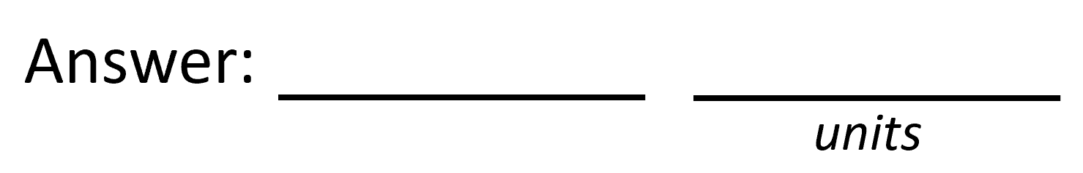

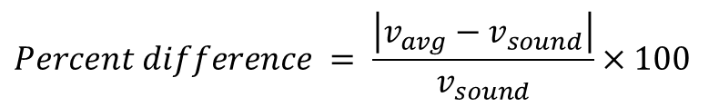

Data Analysis
Average velocity from table
Percent difference where $v_{sound}=343 m/s$
$$v_{avg}= \frac{v_{1}+v_{2}+v_{3}+v_{4}+v_{5}}{5}$$
335.164
m/s
$$Percent difference = \frac{\left|v_{avg}−v_{sound}\right|}{v_{sound}}×100$$
2.28%

Slide 12

Conclusions
Briefly describe and explain the results.
  Answer: The results were determined using measurements of the time it took for sound to travel from the sensor to an object at varying distances. The calculated average velocity was 335.164 m/s which was slightly lower than the accepted speed of sound in air at 343 m/s by an approximate 2.28%.
What is the dependence of temperature, humidity, and atmospheric pressure on the speed of sound? How does it affect the results?
  Answer: The temperature, humidity, and atmospheric pressure can influence the speed of sound by the temperature can influence it depending on higher temperatures result in faster sound speeds because higher temperatures have more kinetic energy and collide more frequently causing sound wave transmission more quickly. Humidity affects the speed of sound by moist air being less dense than dry air because water vapor molecules are lighter causing sound waves to travel slightly faster. Atmospheric pressure generally doesn’t directly affect the speed of sound. This affects the results because if the temperature was slightly lower than the standard temperature for the accepted speed of sound then our calculated average velocity would be lower as it was in this particular experiment which leads me to believe the temperature was lower than the standard.

Slide 13

Gravitational Acceleration of a Free-Falling Object

Slide 14
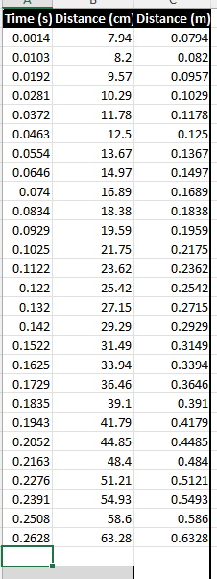
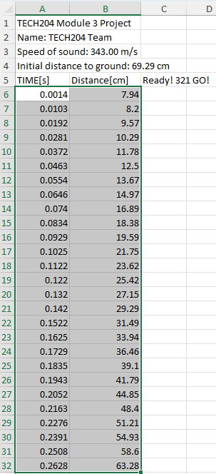
Excel Table
(Screenshot)

Slide 15
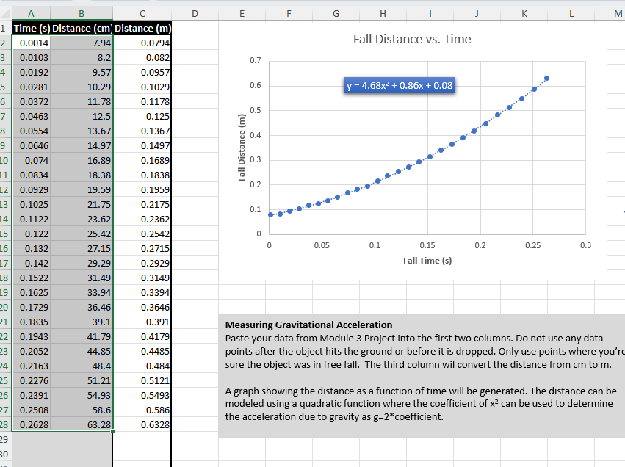
Excel Graph
(Screenshot)

Slide 16
Data Collection
Trial | x² coefficient value from curve fitting | Acceleration (m/s²) = 2* (x² coefficient)
1 | 4.68 | 9.38
2 | 5.02 | 10.04
3 | 4.66 | 9.32
4 | 4.62 | 9.24
5 | 4.73 | 9.46

Slide 17



Data Analysis
Average acceleration from table
Percent difference with $g=9.8 m/s^{2}$
$$a_{avg}= \frac{a_{1}+a_{2}+a_{3}+a_{4}+a_{5}}{5}$$
9.488
m/s²
$$Percent difference =\frac{\left|a_{avg}−g\right|}{g}×100$$
3.18%

Slide 18

Conclusions
Briefly describe and explain the results.
  Answer: The experiment tried to determine the acceleration of a physics textbook with results showing a range of acceleration from 9.24 m/s² to 10.04 m/s² across five different trials. The average acceleration was calculated to be 9.488 m/s² with a percent difference of approximately 3.18%, which indicates that the measured acceleration was slightly lower than the expected value.
How much variation is there from trial to trial? What does this indicate about the uncertainty of the result?
  Answer: The variation from trial to trial is a variation of 0.8 m/s². This indicates that the measurements were not perfectly consistent possibly due to slight measurement errors, or environmental factors like air resistance or friction that could have made the results different.

Slide 19
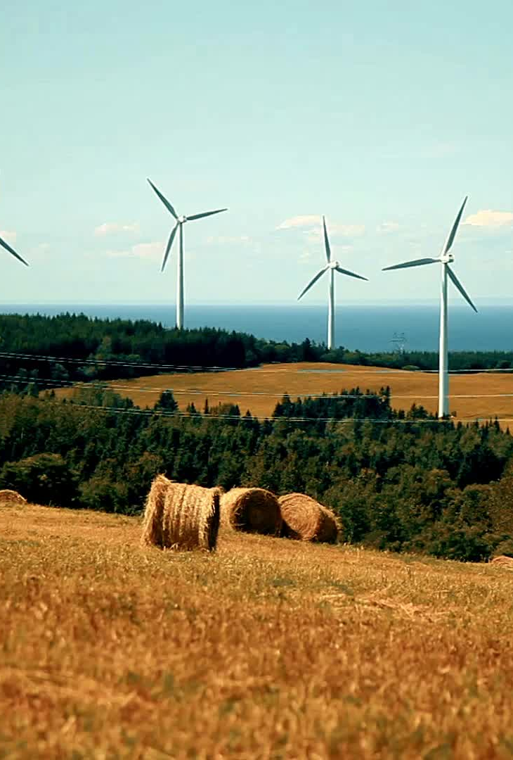
Conservation of Energy of a Free-Falling Object

Slide 20
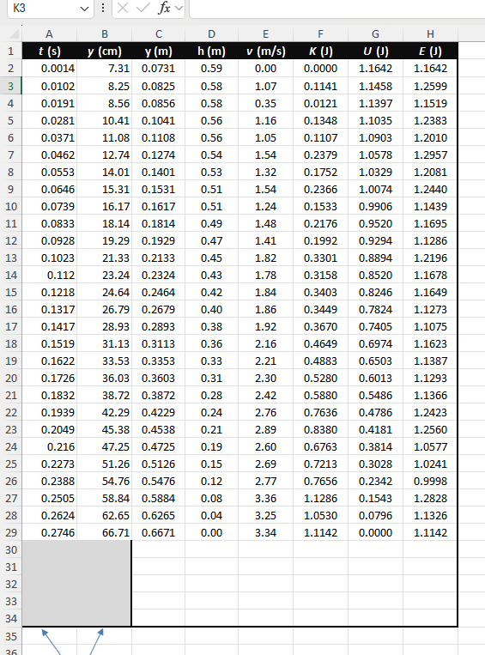
Excel Table
(Screenshot)

Slide 21
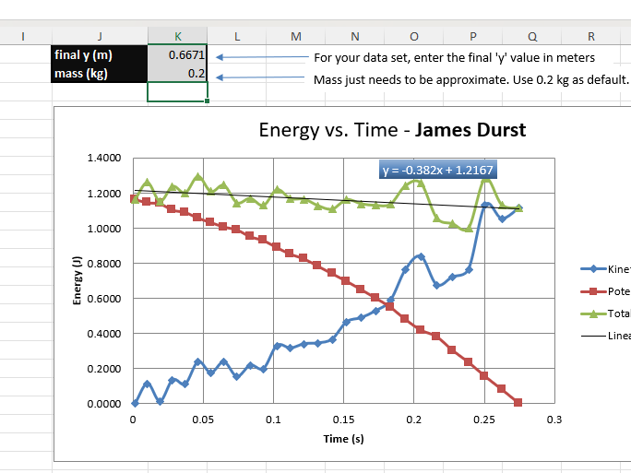
Excel Graph
(Screenshot)

Slide 22

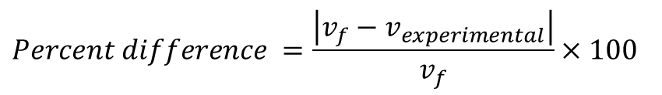


Data Analysis
Theoretical value of final velocity
Final velocity from experimental data (or largest velocity)
Percent difference
$h=y_{final}−y_{initial}=$
0.5940
m
$v_{f}=\sqrt{2gh}=$
3.41
m/s
$v_{experimental}$ =
3.34
m/s
$$Percent difference =\frac{\left|v_{f}−v_{experimental}\right|}{v_{f}}×100$$
2.05
%

Slide 23

Conclusions
Discuss the key characteristics of the plot. Consider the points when potential energy U is maximum, U is minimum, kinetic energy K is maximum, K is minimum and when U and K are the same value. What is the significance of these points?
  Answer: The plot demonstrates the conversion between potential and kinetic energy during the free fall of the object. The relatively constant total energy shows the energy conservation despite the minor deviations due to environmental or other factors. The specific points show the moments when energy is mostly in one form, equally distributed between the two, and then mostly in the other form.

Slide 24

Conclusions
What is the trend of the best fit line for the total energy E in your data? If the data is accurate, the total mechanical energy should decrease slightly. Why is that?
  Answer: Looking at the yellow line representing the total energy, the trend is slightly decreasing over time. The slight decrease is most likely caused by air resistance, internal friction, or sound energy. This is likely to show the decrease because some of the initial potential energy is used by the forces of air resistance, internal friction, or sound energy leading to the small loss of mechanical energy from the falling object and its gravitational potential energy.

Slide 25

Relationship between Linear and Rotational Motion

Slide 26

Data Collection
Object diameter: d =
Object radius: r =
Number of pulses for one revolution: x =
Resolution = $\left(\frac{1 }{x } \frac{Revolution}{pulses}\right)∙\left(\frac{2∙π radians}{1 Revolution}\right)=$
7
cm
3.5
cm
40
0.1571
Radians/pulse

Slide 27
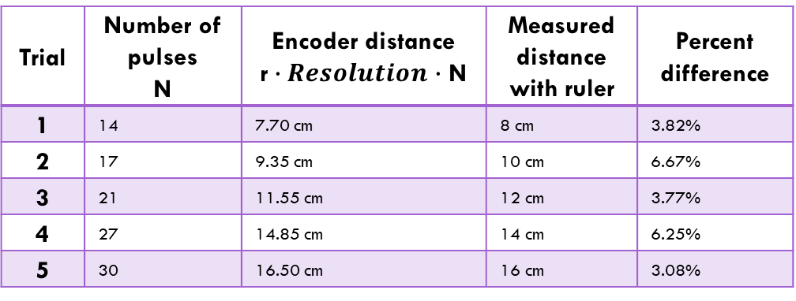
Data Analysis
Trial | Number of pulses N | Encoder distance r$∙Resolution∙$ N | Measured distance with ruler | Percent difference
1 | 14 | 7.70 cm | 8 cm | 3.82%
2 | 17 | 9.35 cm | 10 cm | 6.67%
3 | 21 | 11.55 cm | 12 cm | 3.77%
4 | 27 | 14.85 cm | 14 cm | 6.25%
5 | 30 | 16.50 cm | 16 cm | 3.08%

Slide 28
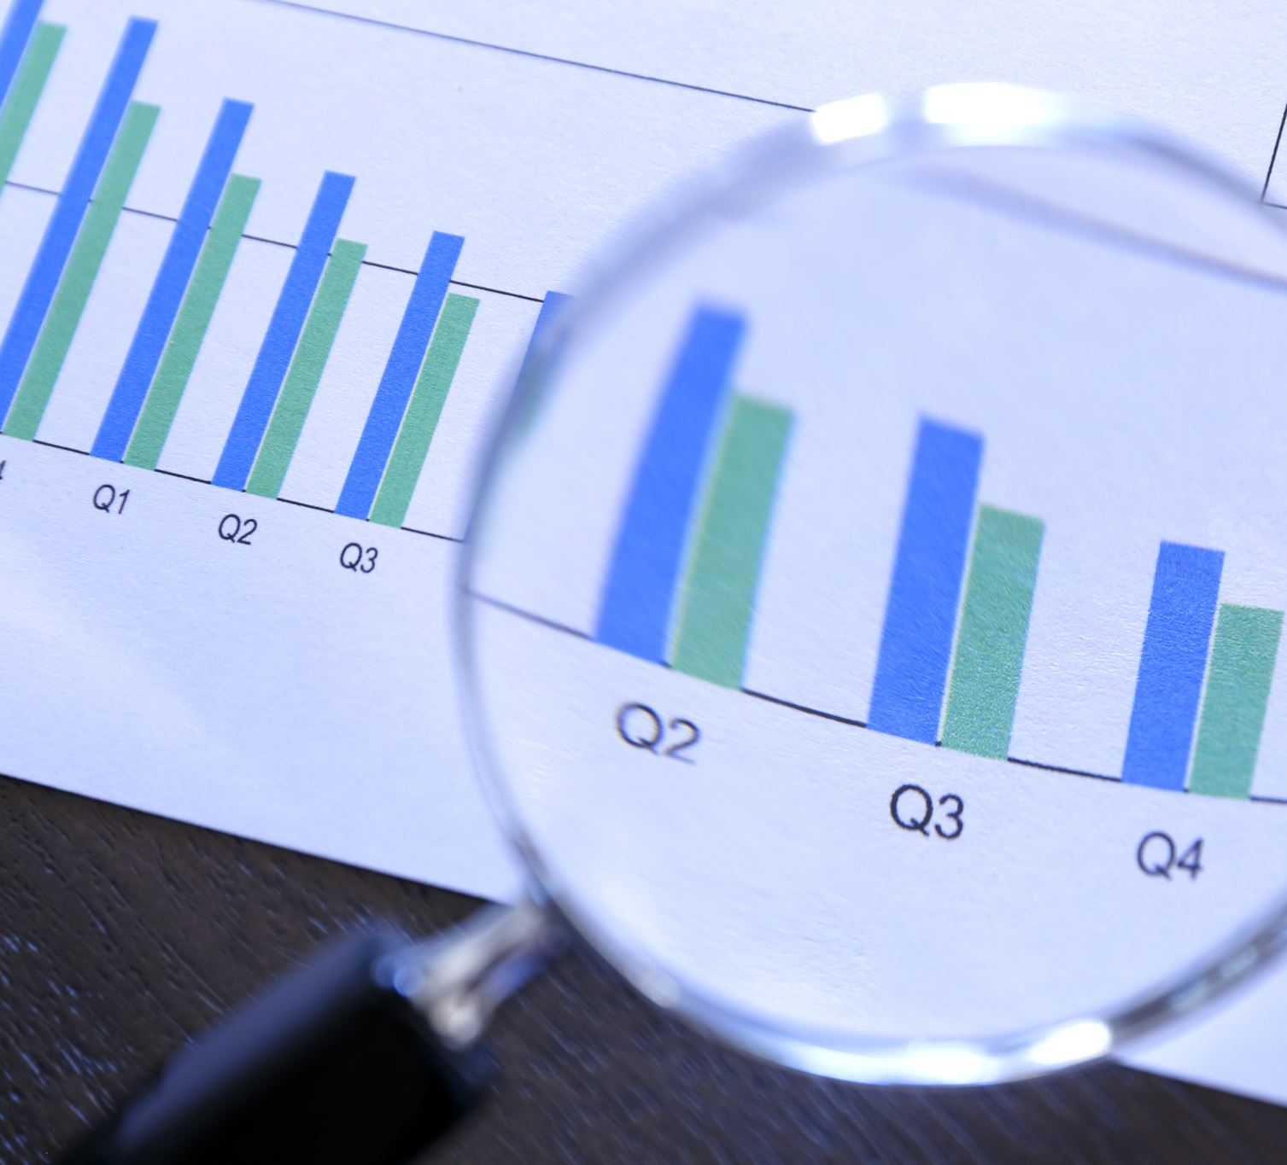
Conclusions
Briefly describe and explain the results.
  Answer: The results show a small percent difference ranging from 3.08% to 6.67%. The difference could possibly be measurement errors or rounding based on what I can see.
What are some applications of this measuring technique? Could this measuring system be used to measure surfaces that are not flat?
  Answer: Some applications that can use this measuring technique are simple distance measurement, educational demonstrations, and basic material feed measurements. This measuring system can not be used to measure surfaces that are not flat.

Slide 29

Observing the Hall Effect

Slide 30
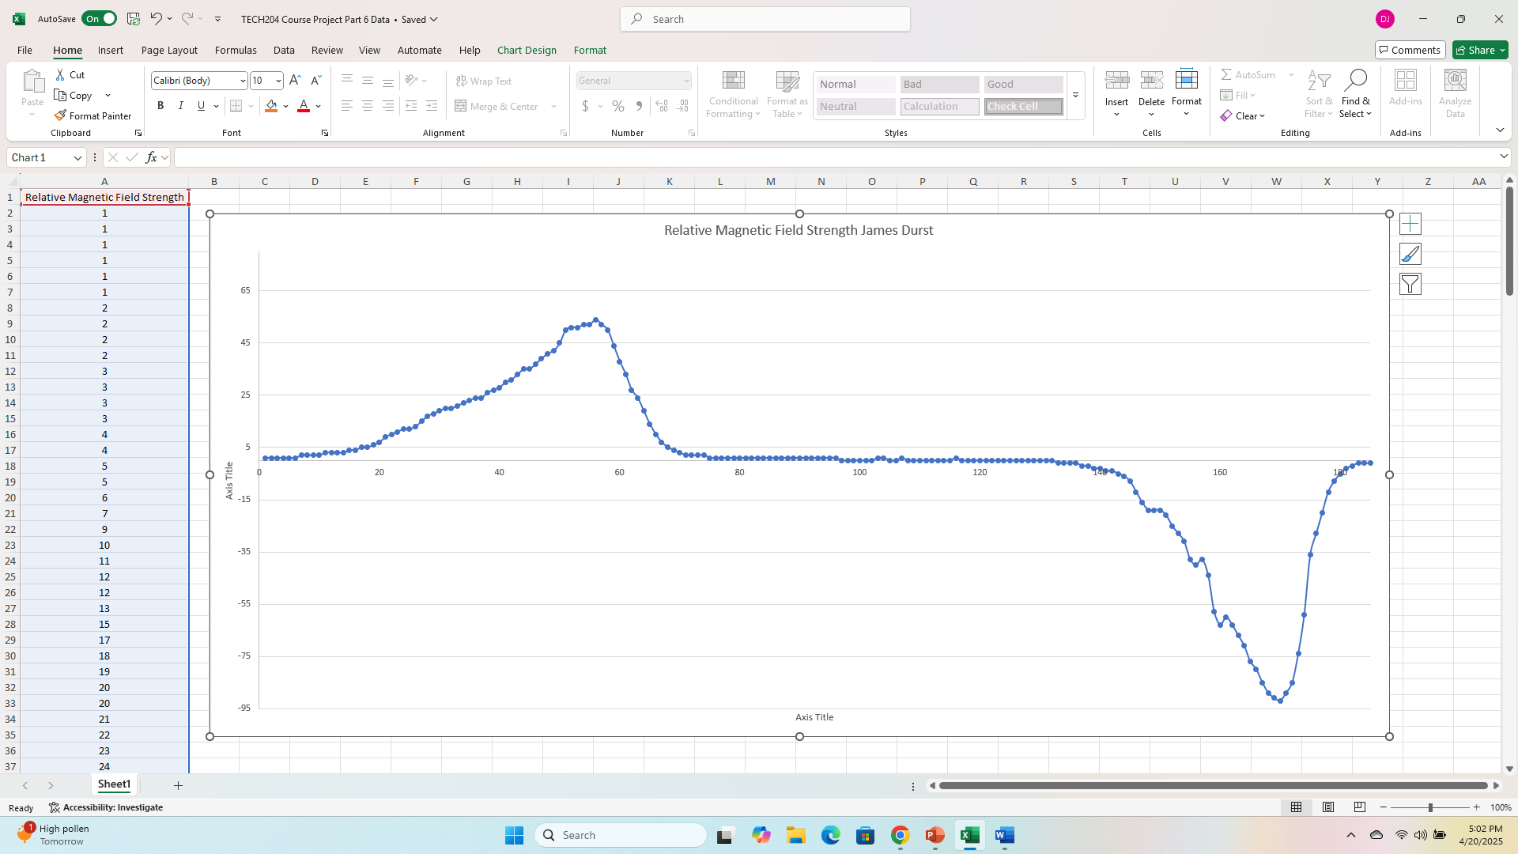
Excel Graph
(Screenshot)

Slide 31
Conclusions
Briefly describe and explain the results.
Answer: The chart shows how the relative magnetic field changes over time. Initially, we see the field is stable then starts to increase until it peaks, then stabilizes then decreases into the negative field then increasing to stabilize again. This suggests a magnetic event or movement causing the field strength to vary in both magnitude and direction.
Describe how the Hall sensor works. What are some applications for the Hall effect sensor?
Answer: The Hall sensor works based on the Hall effect which measures the Current Flow, Lorentz Force, Charge Accumulation, and the Hall Voltage Generation. Hall effect sensors are used in position and speed sensing in automotive systems, current sensing in a current-carrying wire, magnetic field measuring, some security systems and automotive ignition systems.

Slide 32
Challenges
Making time while working full time with 6 kids and family as well as going to school full-time.
1
Refreshing memory on calculating the answers to the questions with the proper formulas.
2

Slide 33
Career skills gained
Ability to apply trigonometric identities and derived quantities as they relate to linear motion.
Ability to describe the effects of various forces and apply Newton’s Laws of Motion.
Ability to understand the conservation laws of energy and momentum.
Ability to analyze situations in which an object undergoes circular motion.
Ability to apply the fundamental concepts of electricity, such as charge, electric fields, electric potential, and current.
Ability to apply the fundamental concepts of magnetism, such as magnetic fields, magnetic forces, and electromagnetic induction. .
Ability to evaluate and characterize various types of waves, including light and sound.
Ability to produce a portfolio using multiple IoT sensors and devices to demonstrate applications of physics.

Slide 34

Thank you
James Durst
Tech 204

Slide 35
References
https://maxbotix.com/blogs/blog/how-ultrasonic-sensors-work?srsltid=AfmBOoruPHkWnm6q__Vf9PSmSfbOw6C1Du0iUVyURFaGPw4qDZ6bMb4G
https://www.circuitschools.com/what-is-rotary-encoder-types-principle-working-in-detail/
https://www.electronics-tutorials.ws/electromagnetism/hall-effect.html
https://www.physicsclassroom.com/class/sound/Lesson-2/The-Speed-of-Sound
https://www.nde-ed.org/Physics/Sound/speedinmaterials.xhtml
https://wonderopolis.org/wonder/How-Does-Temperature-Affect-the-Speed-of-Sound
https://en.wikipedia.org/wiki/Speed_of_sound
https://www.dynapar.com/knowledge/applications/encoder-linear-measurement/
http://www.monolithicpower.com/en/learning/resources/hall-effect-sensors-a-comprehensive-guide
https://www.ti.com/lit/pdf/sszt164
https://www.electronics-tutorials.ws/electromagnetism/hall-effect.html
https://www.digikey.com/en/blog/hall-effect-sensor-basics

